Slide 1
Object Oriented Programming and Design
Presented by
Dr Ramya Devi M
mramyadevi@wilp.bits-pilani.ac.in
CS - 12 : 11th Oct 2025

Slide 2
COLLECTIONS

Slide 3
Learning Objectives
Collection Framework
(i) Defintion and Hierarchy
(ii) Benefits
Collection Interface
ArrayList implementation
Linked List implementation
Comparison between Array List and LinkedList
Stack
Object Oriented Programming

Slide 4
Collections Framework
The java.util package contains one of the most powerful subsystems called Collections.
A collection is a group of objects.
It is sometimes called as a container which is used to store, retrieve, manipulate and communicate aggregated data.
A Collection Framework is an unified architecture to represent and manipulate collections and it contains the following:
Interfaces – Abstract data types that allow collections to be
manipulated independently of the details of their representation
Implementation – These are the concrete implementation
of collection interface.
They are actually reusable data structures
Object Oriented Programming

Slide 5
Collections Framework
(iii) Algorithms – These are the methods that perform useful computations such as searching and sorting data in objects by implementing collection interfaces.
Benefits
Reduces Programming - Provides useful data structures and algorithms
Increases Programming Speed and quality – Provides high performance and high quality implementations.
Because we are freed from writing our own data structures, we have more time to develop quality programs.
Software Reuse – Users can include their own new algorithms in the existing data structures by means of reuse property
Object Oriented Programming

Slide 6
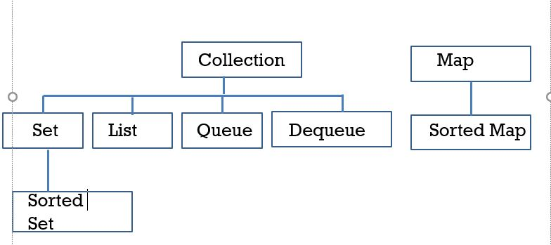
Collections - Interface

Slide 7
Collections - Interface
Collection - It is the root of the collection hierarchy
Set – It is a collection that does not contain duplicate elements
List – It can contain duplicate elements. It is an ordered collection ( Sometimes called a Sequence)
Queue – It is FIFO (First in First out ) data structure in which element is inserted in an end called as Rear and the element is deleted at another end called as Front.
Stack – It is LIFO (Last in First out ) data structure in which element is inserted and deleted in a same end called as Top.
Dequeue - It can be used as both LIFO and FIFO
Map – It is an object that maps keys to values. A map can’t contain duplicate keys.
Sorted Set – It is a set that maintains its elements in ascending order
Object Oriented Programming

Slide 8
Collections - Interface
Sorted Map - It is a map that maintains its mapping in
ascending key order.
The List Interface
This is a child interface of the collection interface. This interface is dedicated to the data of the list type in which we can store all the ordered collection of the objects. This also allows duplicate data to be present in it. This list interface is implemented by various classes like ArrayList, Vector and Stack. etc. Since all the subclasses implement the list, we can instantiate a list object with any of these classes. For example,
List <T> al = new ArrayList<> ();
List <T> ll = new LinkedList<> ();
List <T> v = new Vector<> ();
Where T is the type of the object
The classes which implement the List interface are as follows:
Object Oriented Programming

Slide 9
Collections - ArrayList
1. ARRAYLIST
ArrayList provides us with dynamic arrays in Java.
Though, it may be slower than standard arrays but can be helpful in programs where lots of manipulation in the array is needed.
The size of an ArrayList is increased automatically if the collection grows or shrinks i.e. if the objects are added or removed from the collection.
Java ArrayList allows us to randomly access the list.
ArrayList can not be used for primitive types, like int, char, etc.
We will need a wrapper class for such cases.
Some of the methods in array list are listed below:
Object Oriented Programming

Slide 10
Collections - ArrayList
Method | Description
boolean add(Collection c) | Appends the specified element to the end of a list.
void add(int index, Object element) | Inserts the specified element at the specified position.
void clear() | Removes all the elements from this list.
int lastIndexOf(Object o) | Return the index in this list of the last occurrence of the specified element, or -1 if the list does not contain this element.
void trimToSize() | Trims the capacity of this ArrayList instance to be the list’s current size.
\
Let us understand Array list with a programmatic example:
Object Oriented Programming

Slide 11
How ArrayList Works Internally
Initial Capacity: When you create an ArrayList, it has an initial capacity (default is 10 if not specified). This means the internal array can hold up to 10 elements before it needs to grow.
Dynamic Growth: If you add more elements than the current capacity, the ArrayList automatically increases its capacity, typically by 1.5 times the current capacity.
Unused Capacity: After adding and removing elements, the list might have unused capacity—extra space in the internal array that is not used by the current elements. This extra capacity is kept to minimize resizing operations during future additions.

Slide 12
Why Use trimToSize()?
When you know that:
No more elements will be added to the ArrayList.
You want to free up memory used by the unused capacity.
You can call trimToSize() to shrink the internal array to match the current number of elements (size()).
When Should You Use It?
Memory Optimization: If your program creates large ArrayLists that no longer need to grow, trimToSize() helps reduce memory usage by eliminating unused capacity.
Finalizing a List: If an ArrayList is no longer going to change, and you want to optimize it before passing it to another part of your program.

Slide 13
Collections - ArrayList
import java.util.*;
class ArrayListDemo
{
public class void main(String s[ ] )
{
ArrayList A = new ArrayList( ); // Creating an Array
A.add(“Sachin”);
A.add(“Dhoni”);
Iterator it = A.iterator( );
while(it.hasNext( ) )
{
System.out.println(“\n Element “+it.next( ) );
}
}
Object Oriented Programming

Slide 14
Iterator Methods
hasNext():
Returns true if there are more elements to iterate over.
Otherwise, it returns false.
next():
Returns the next element in the iteration.
Throws a NoSuchElementException if no more elements exist.
remove():
Removes the last element returned by the next() method from the collection.
Can only be called once per call to next().
Throws IllegalStateException if called without a preceding next().

Slide 15
Collections - ArrayList
The output of the above code is:
Element : Sachin
Element : Dhoni
In the code,
An Iterator is an object that iterates over the elements in a collection.
The java.util.Iterator is an interface specifying the capabilities of an iterator.
If we call method of Iterator( ) object, it returns an iterator object that implements Iterator and knows how to step through the objects in the underlying collection.
Iterator interface specifies the following methods:
- hasNext( ) – Returns true if there are more elements in the collection. Otherwise, it returns False.
Object Oriented Programming

Slide 16
Collections – Linked List
next ( ) - Returns the next element
Remove( ) - Removes from the collection the last element returned by the iterator
2. LinkedList Class - LinkedList class is an implementation of the LinkedList data structure which is a linear data structure where the elements are not stored in contiguous locations and every element is a separate object with a data part and address part. The elements are linked using pointers and addresses. Each element is known as a node.
Why do we need a Linked List?
We know that arrays have certain limitations such as:
1) Size of the array is fixed which is decided when we create an array so it is hard to predict the number of elements in advance, if the declared size fall short then we
Object Oriented Programming

Slide 17
Collections – Linked List
cannot increase the size of an array and if we declare a large size array and do not need to store that many elements then it is a waste of memory.
2) Array elements need contiguous memory locations to store their values.
3) Inserting an element in an array is performance wise expensive as we have to shift several elements to make a space for the new element. For example:
Let’s say we have an array that has following elements: 10, 12, 15, 20, 4, 5, 100, now if we want to insert a new element 99 after the element that has value 12 then we have to shift all the elements after 12 to their right to make space for new element.
Similarly deleting an element from the array is also a performance wise expensive operation because all the elements after the deleted element have to be shifted left.
Object Oriented Programming

Slide 18
Collections – Linked List
These limitations are handled in the Linked List by providing following features:
1. Linked list allows dynamic memory allocation, which means memory allocation is done at the run time by the compiler and we do not need to mention the size of the list during linked list declaration.
2. Linked list elements don’t need contiguous memory locations because elements are linked with each other using the reference part of the node that contains the address of the next node of the list.
3. Insert and delete operations in the Linked list are not performance wise expensive because adding and deleting an element from the linked list doesn’t require element shifting, only the pointer of the previous and the next node requires change.
Object Oriented Programming

Slide 19
Collections – Linked List
Methods in LinkedList
Boolean add(Object item): It adds the item at the end of the list
Void add(int index, Object item): It adds an item at the given index of the the list
Void addFirst(Object item): It adds the item (or element) at the first position in the list
Void addLast(Object item): It inserts the specified item at the end of the list
Void clear(): It removes all the elements of a list
Object get(int index): It returns the item of the specified index from the list
Object getFirst(): It fetches the first item from the list
Object getLast(): It fetches the last item from the list
Object Oriented Programming

Slide 20
Collections – Linked List
9. Object remove(): It removes the first element of the list.
10. Object remove(int index): It removes the item from the list which is present at the specified index
11. Object remove(Object obj): It removes the specified object from the list.
12. Object removeFirst(): It removes the first item from the list.
13. Object removeLast(): It removes the last item of the list.
import java.util.*;
public class JavaExample
{
public static void main(String args[])
{
Object Oriented Programming

Slide 21
Collections – Linked List
LinkedList<String> list=new LinkedList<String>();
//Adding elements to the Linked list
list.add(“Kohli");
list.add(“Laxman");
list.add(“Sachin");
list.add(“Dhoni");
list.add(“Dravid");
//Adding an element to the first position
list.addFirst(“Ganguly");
//Adding an element to the last position
list.addLast(“Pant");
//Adding an element to the 3rd position
list.add(2, “Jadeja");
Object Oriented Programming

Slide 22
Collections – Linked List
//Removing First element
//Same as list.remove(0);
list.removeFirst();
//Removing Last element
list.removeLast();
//Iterating LinkedList
Iterator<String> iterator=list.iterator();
while(iterator.hasNext()){
System.out.println(“Name: ”+iterator.next()+" ");
}
Object Oriented Programming

Slide 23
Collections – Linked List
//removing 2nd element, index starts with 0
list.remove(1);
System.out.print("\nAfter removing second element: ");
//Iterating LinkedList again
Iterator<String> iterator2=list.iterator();
while(iterator2.hasNext()){
System.out.print(“Name: ”+iterator2.next());
}
}
}
Object Oriented Programming

Slide 24
Collections – Linked List
The output of the above code is
Name : Kohli
Name : Laxman
Name : Jadeja
Name : Sachin
Name : Dhoni
Name: Dravid
After removing second element:
Name : Kohli
Name : Laxman
Name : Sachin
Name : Dhoni
Name: Dravid
Object Oriented Programming

Slide 25
Collections - Vector
Vector class
Vector is a type of data structure that maintains insertion order, that is elements are retrieved in same order as they are added into it. It is very much similar to ArrayList.
The methods in Vector Class
1. boolean add(E e) - This method adds element at the end of the vector
2. void add(int index, E element) - This method adds an element at specified index and moves the whole elements one step in forward direction
3. void addElement(E obj) - This method adds the specified element at the end of the vector also increasing its size by 1
4. int capacity() - This method gives the capacity of the vector
Object Oriented Programming

Slide 26
Collections - Vector
5. Object elementAt(int index) - This method gives specific element at index mentioned in the argument
6.boolean equals(Object o) - This method checks the equality of object with this vector
7.Object firstElement() - This method returns the first element at index 0
8. Object get(int index) - This method retrieves an element at specified index
9. int indexOf(Object o) - This method retrieves the index of the first occurrence of the specified element in the vector, or -1 if that element is not present
10. void insertElementAt(Object o, int index) - This method inserts the specified element at specified position and moves all the elements one step further
Object Oriented Programming

Slide 27
Collections - Vector
11. Object lastElement() - This method returns the last element of the vector
12. Object remove(int index) - This method removes an element at specified index
13. Object set(int index, Object element) - This method replaces the element with the element specified in the method at the specified index
14. int size() - This method gives the number of elements in the vector,
15. List subList(int fromIndex, int toIndex) - This method returns group of elements between fromIndex(inclusive) and toIndex(exclusive)
Object Oriented Programming

Slide 28
Collections - Vector
(iii) Example program for removing elements
import java.util.*;
import java.io.*;
class RemovingElementsFromVector {
public static void main(String[] arg)
{
// create default vector of capacity 10
Vector v = new Vector();
// Add elements using add() method
v.add(1);
v.add(2);;
v.add(“Jave");
v.add("forAll");
v.add(4);
Object Oriented Programming

Slide 29
Collections - Vector
// removing first occurrence element at 1
v.remove(1);
// checking vector
System.out.println("After removal: " + v);
}
}
The output of the above code is
After removal: [1, Java, forAll, 4]
Object Oriented Programming

Slide 30
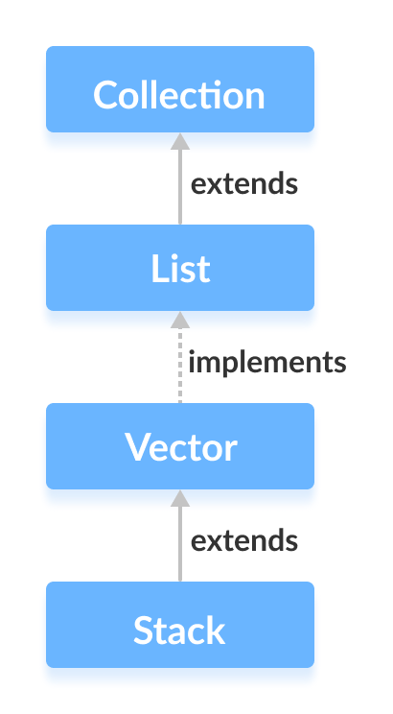
Collections - Stack
Java Stack Class
The Java collections framework has a class named Stack that provides the functionality of the stack data structure.
The Stack class extends
Object Oriented Programming

Slide 31
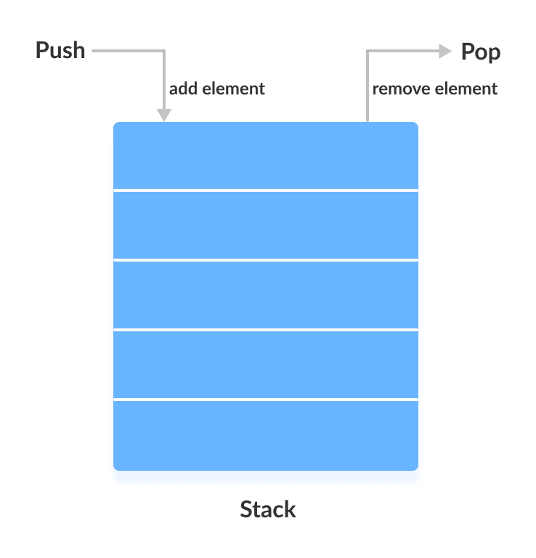
Collections - Stack
Stack Implementation
In stack, elements are stored and accessed in Last In First
Out manner. That is, elements are added to the top of the stack
and removed from the top of the stack.
Object Oriented Programming

Slide 32
Collections - Stack
Creating a Stack
In order to create a stack, we must import the java.util.stack
package first. Once we import the package, here is how we
can create a stack in Java.
Stack <type> S = new Stack< > ();
Examples:
Stack <Integer> S = new Stack< > (); // Creating Integer Stack
Stack <String> S = new Stack< > (); // Creating String Stack
Stack Methods
Since Stack extends Vector class, it inherits all the methods of
Vector. Besides these methods, the Stack class includes 5
more methods that distinguish it from Vector.
Object Oriented Programming

Slide 33
Collections - Stack
Stack-Specific Methods:
push(E item)
pop()
peek()
empty()
search(Object o)
Object Oriented Programming

Slide 34
Collections - Stack
Methods Inherited from Vector:
Since Stack extends Vector, it also inherits several methods from the Vector class, including:
add(E e)
addElement(E obj)
size()
clear()
get(int index)
indexOf(Object o)
remove(int index)
removeElement(Object obj)
toArray()
Object Oriented Programming

Slide 35
Collections - Stack
1. push() Method
To add an element to the top of the stack, we use the
push( ) method.
2.pop() Method
To remove an element from the top of the stack, we use the pop() method.
3. search() Method
To search an element in the stack, we use the search( ) method. It returns the position of the element from the top of the stack.
empty() Method
To check whether a stack is empty or not, we use the
empty( ) method.
Object Oriented Programming

Slide 36
Collections - HashMap
HashMap in Java with Example
HashMap is a Map based collection class that is used for storing Key & value pairs, it is denoted as HashMap<Key, Value> or HashMap<K, V>. This class makes no guarantees as to the order of the map. It is similar to the Hashtable class except that it is unsynchronized and permits nulls(null values and null key).
It is not an ordered collection which means it does not return the keys and values in the same order in which they have been inserted into the HashMap. It does not sort the stored keys and Values. You must need to import java.util.HashMap or its super class in order to use the HashMap class and methods.
Object Oriented Programming

Slide 37
Collections - HashMap
HashMap Class Methods
Here is the list of methods available in HashMap class. I have also covered examples using these methods at the end of this post.
1.void clear(): It removes all the key and value pairs from the specified Map.
2.boolean containsKey(Object key): It is a boolean function which returns true or false based on whether the specified key is found in the map.
3.boolean containsValue(Object Value): Similar to containsKey() method, however it looks for the specified value instead of key.
Object Oriented Programming

Slide 38
Collections - HashMap
4.Value get(Object key): It returns the value for the specified key.
5.boolean isEmpty(): It checks whether the map is empty. If there are no key-value mapping present in the map then this function returns true else false.
6.Set keySet(): It returns the Set of the keys fetched from the map.
7.value put(Key k, Value v): Inserts key value mapping into the map. Used in the above example.
8.int size(): Returns the size of the map – Number of key-value mappings.
9.Collection values(): It returns a collection of values of map.
10.Value remove(Object key): It removes the key-value pair for the specified key. Used in the above example.
Object Oriented Programming

Slide 39
Iterators and ListIterators
Iterator
Iterator interface present in java.util package. It is used to read or
remove the collection elements by iterating over specified collection.
Note: Iterator interface can be applied to all collection classes but
it can traverse only in single direction that is Forward direction.
The iterator() method of Collection interface is used to get the Iterator
interface.
Iterator iterator = Collection.Iterator();
Object Oriented Programming

Slide 40
Iterators and ListIterators
ListIterator
Iterator interface present in java.util package. It extends java.util.Iterator
interface. It is used to read, remove, add, and update the collection
elements by iterating over specified List type collection.
Note: Iterator interface can be applicable only on List objects like
ArrayList or LinkedList but it can traverse in both directions that
is Forward as well as Backward direction.
The listIterator() method of List interface is used to get the ListIterator
object.
ListIterator listIterator = list.listIterator();
Object Oriented Programming

Slide 41
Iterators and ListIterators
Difference between Iterator and ListIterator in java
Both of these interfaces are used for traversing but still there are few differences in the way they can be used for traversing a collection.
Iterator vs ListIterator
1) Iterator is used for traversing List and Set both.
We can use ListIterator to traverse List only, we cannot traverse Set using ListIterator.
2) We can traverse in only forward direction using Iterator.
Using ListIterator, we can traverse a List in both the directions (forward and Backward).
3) We cannot obtain indexes while using Iterator
We can obtain indexes at any point of time while traversing a list using ListIterator. The methods nextIndex() and previousIndex() are used for this purpose.
Object Oriented Programming

Slide 42
Iterators and ListIterators
4) We cannot add element to collection while traversing it using Iterator,
it throws ConcurrentModificationException when we try to do it.
We can add element at any point of time while traversing a list using
ListIterator.
5) We cannot replace the existing element value when using Iterator.
By using set(E e) method of ListIterator we can replace the last element
returned by next() or previous() methods.
Methods of Iterator:
hasNext() - It returns true if Iterator has more element to iterate.
next() - It returns the next element in the collection until the
hasNext() method returns true. This method throws
‘NoSuchElementException’ if there is no next element.
Object Oriented Programming

Slide 43
Iterators and ListIterators
remove() - It removes the current element in the collection. This
Method throws ‘IllegalStateException’ if this function is called before
next( ) is invoked.
Methods of ListIterator:
add(E e) - The add() method of ListIterator interface is used to insert
the given element into the specified list. The element is inserted
automatically before the next element may return by next() method.
hasNext() - The hasNext() method of ListIterator interface is used to
return true if the given list iterator contains more number of element
during traversing the given list in the forward direction.
hasPrevious() - The hasPrevious() method of ListIterator interface is
used to retrieve and remove the head of the deque.
Object Oriented Programming

Slide 44
Iterators and ListIterators
next() - The next() method of ListIterator interface is used to return the
next element in the given list. This method is used to iterate through the
list.
nextIndex() - The nextIndex() method of ListIterator interface is used to
return the index of the element which is returned by the next() method.
previous() - The previous() method of ListIterator interface is used to
return the previous element from the list and moves the cursor in a
backward position. The above method can be used to iterate the list in
a backward direction.
remove() - The remove() method of ListIterator interface is used to
remove the last element from the list which is returned by next() or
previous() method. The above method can only be called if the add(E)
has not been called.
Object Oriented Programming

Slide 45
Iterators and ListIterators
Iterator | ListIterator
It is part of Collection framework and introduced in Java 1.2 version | It is part of Collection framework and introduced in Java 1.2 version
It can be applied to any collection classes. | Only applicable for List objects like ArrayList , LinkedList, Vector.
Can traverse only in FORWARD direction | Can traverse in both FORWARD and BACKWARD directions.
It can perform read as well as remove operation. | It can perform read, add, remove, and update operations.
The iterator() method of any collection class can be used to get Iterator object. For example, Iterator iterator= collection.iterator(); | The listIterator() method of any List classes can be used to get ListIterator objectFor example, ListIterator listIterator = list.listIterator();
Object Oriented Programming

Slide 46
Thanks

